Slide 1
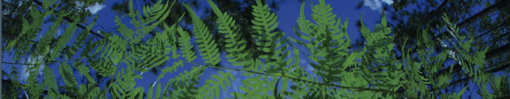

LifeMapper
University of Florida

Slide 2
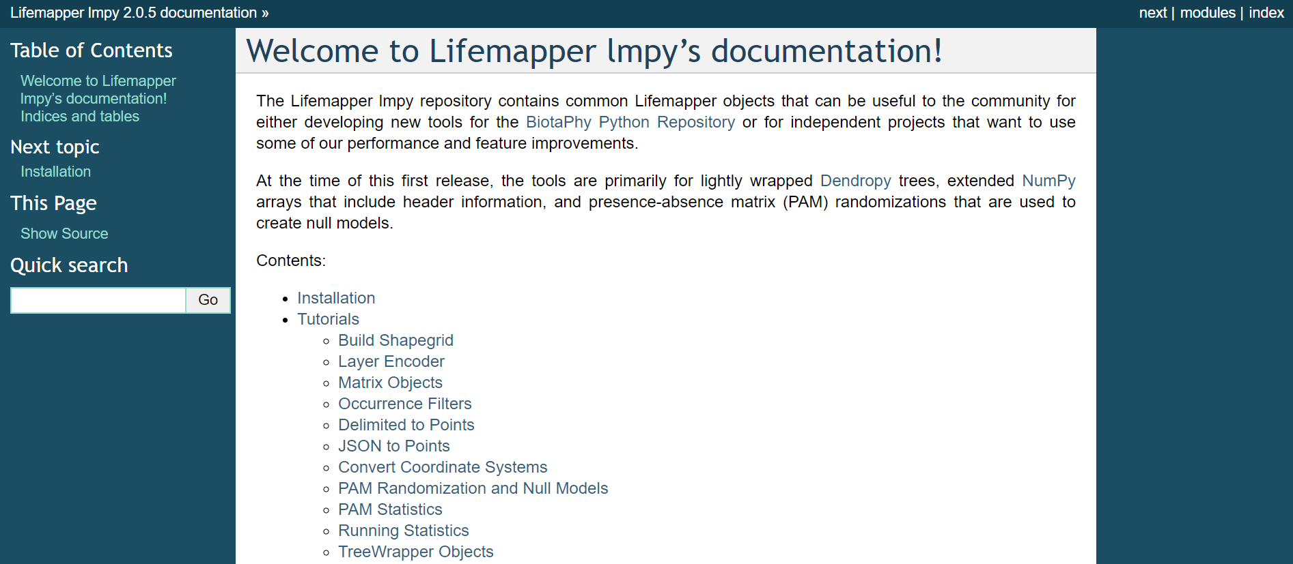

Slide 3
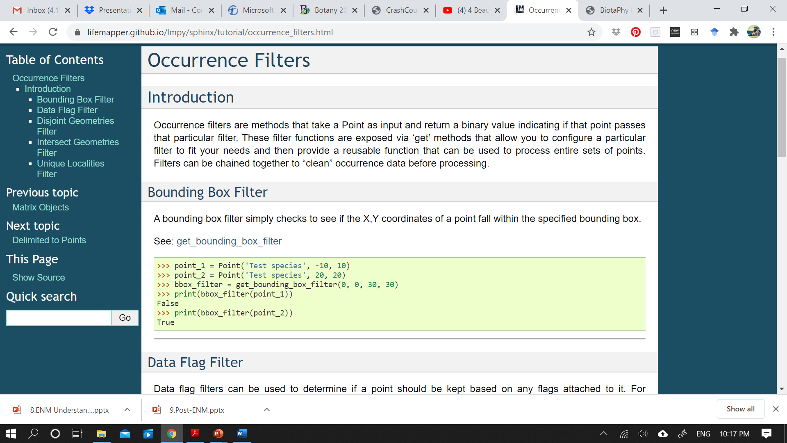

Slide 4
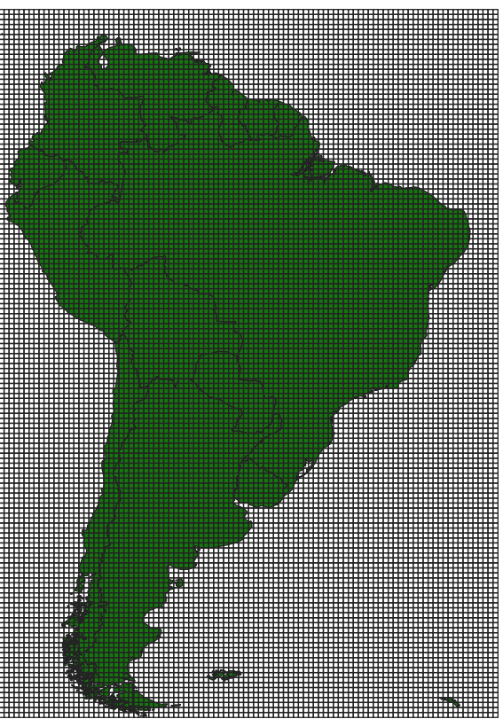
South America’s bounding box organized into an equal sized cell grid

Slide 5
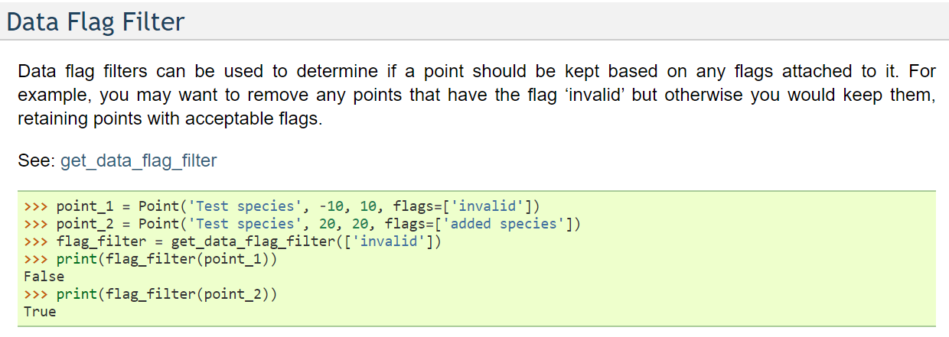
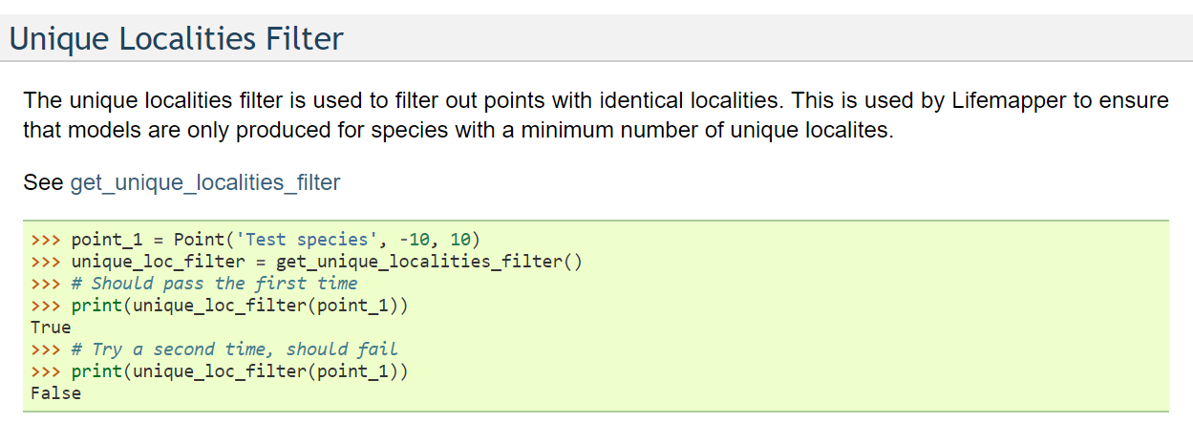
invalid,
mismatched, and
suspect taxonomy,
datum missing and errors,
geocode errors,
points at the origin
duplicates distributed to multiple collections → same record accounted twice in data aggregators.
overlap between occurrence sources, iDigBio and GBIF

Slide 6
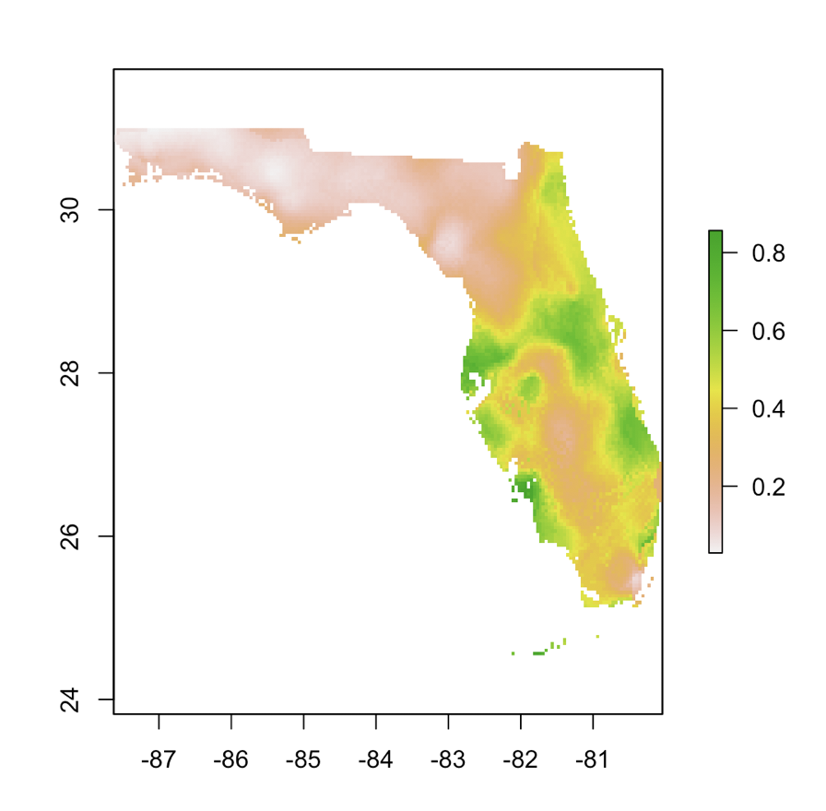

With filtered occurrence points you can now build a species distribution model for each species in your community!
1
2
Encode this information into a Presence Absence Matrix (PAM)
community
3
4

Slide 7
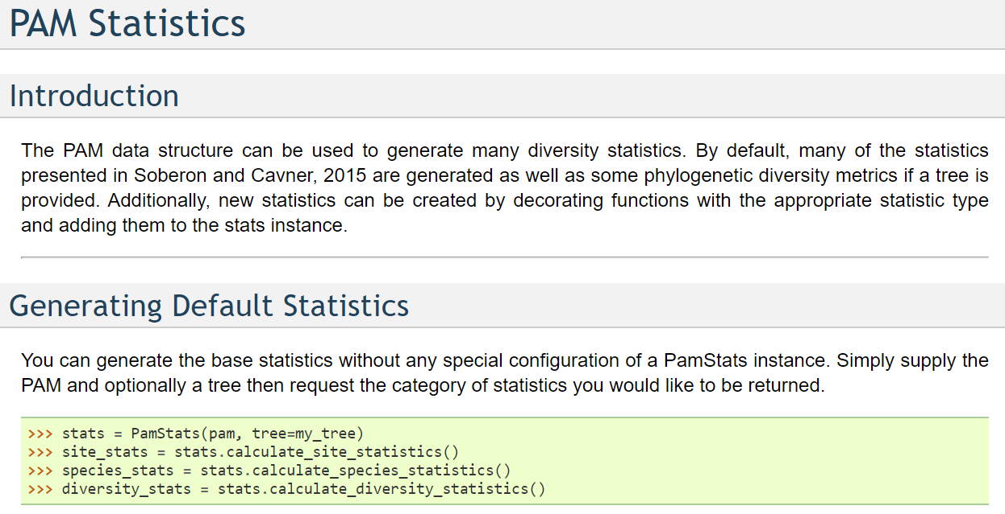

Slide 8
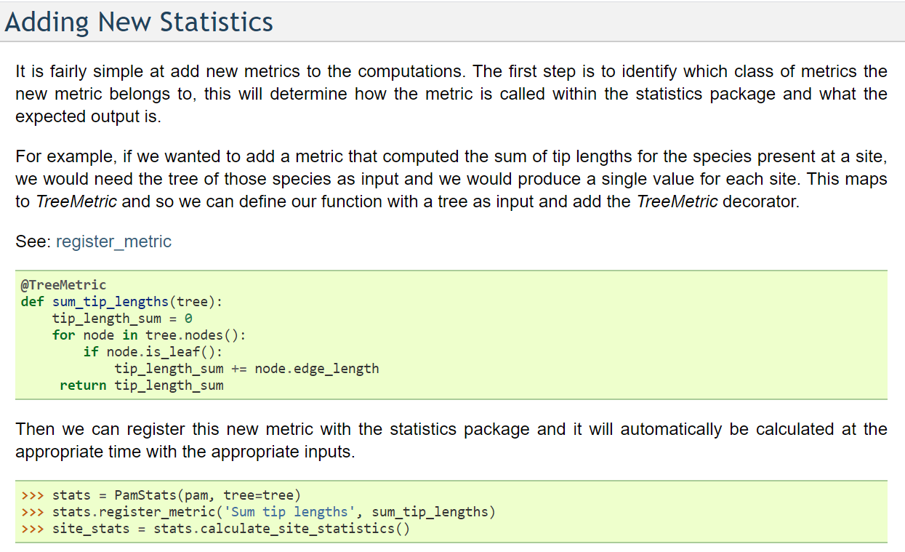

Slide 9
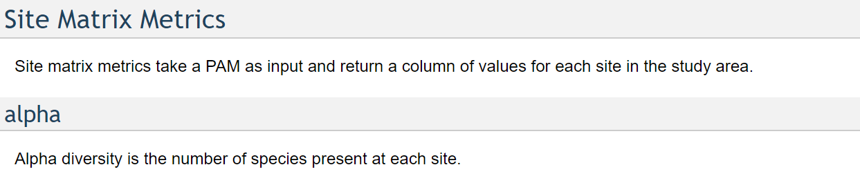
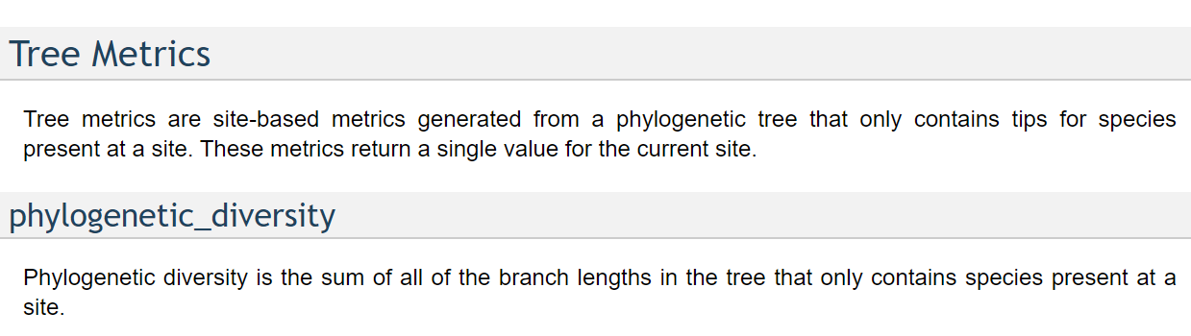
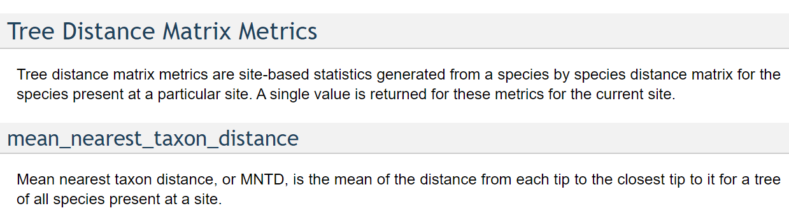

Slide 10
EXAMPLE

Slide 11



Retrieving phylogenetic and spatial data
1
2
3
cleaning steps:
Bounding box →
South America
(-82,-56,-32,15).
Unique
Sufficient
Correctly assigned
SDM
Dated seed plant phylogeny by Smith & Brown (2018) → only accepted names.
Occurrence data
SDM
SDM
PAM
SDM
SDM
Notes:
To conduct our study we retrieved phylogenetic and spatial data, in a process divided in three parts. First, we retrieved a dated seed plant phylogeny published by Smith & Brown to infer phylogenetic relationships for taxa limited to South America. We ensured taxa included in our analyses presented only accepted names and we created a bounding box to capture the entire continent of South America. Second, we downloaded occurrence data from iDigBio and GBIF and performed a series of cleaning steps following scripts available from LifeMapper. We ensured occurrence points were unique, correctly assigned and sufficient to properly build spatial distribution models (SDM). Occurrence points correctly assigned didn’t present bad GBIF and iDigBio flags. Also, we removed occurrence points outside the distribution predicted by Plants of the World Online.

Slide 12
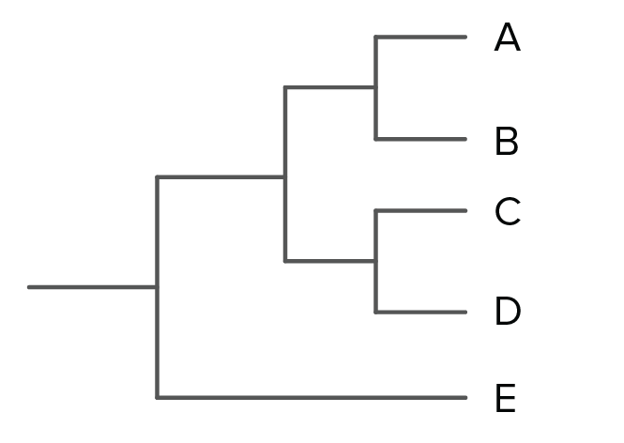
Adding new statistics to our PAM
Mean Node Height: corresponds to to the MRCA age of every internal node in the phylogeny
h
f= 7mya,
g= 4mya,
h=2mya,
i= 2mya
g
i
f
7+4+2+2 = 3.75mya
4
2mya
Notes:
We defined a metric, Mean Node Height, to determine the age of each community. If you look at this phylogeny it is easy to understand this metric. It corresponds to the . Following this procedure, we combined the environmental variables with the PAM matrices and the age metric for each community so that all of our variables could be stored in a single matrix for South America. Then, we performed simple and multiple linear regressions using community age as a response variable and environmental variables as predictors. Calculations were conducted in R as well as plotting of graphs and maps were plotted in QGIS.

Slide 13
Retrieving environmental data
WorldClim
Bioclim 1 (Annual Mean Temperature)
gtopo30
Elevation
Soil Grids
Sand content, Coarse fragment volumetric.
Notes:
For environmental data, we used four different databases, WorldClim, Paleoclim, Soil Grids and gtopo30. From WorldClim we used Annual Mean Temperature, Temperature Annual Range, Annual Precipitation and Precipitation of Driest Quarter. From Paleoclim we calculated pairwise distance between six different time frames for temperature and precipitation data. From Soil Grids we used Sand content, Soil organic carbon content, Soil ph in water, and Coarse fragment volumetric and finally, from gtopo30, we used elevation.

Slide 14
Integrating spatial, phylogenetic, and environmental data
Combined the grid cell age metrics with the environmental variables
Performed simple and multiple linear regressions using community age as a response variable and environmental variables as predictors.
Calculations and graphs in R and maps plotted in QGIS.
Notes:
We defined a metric, Mean Node Height, to determine the age of each community. If you look at this phylogeny it is easy to understand this metric. It corresponds to the . Following this procedure, we combined the environmental variables with the PAM matrices and the age metric for each community so that all of our variables could be stored in a single matrix for South America. Then, we performed simple and multiple linear regressions using community age as a response variable and environmental variables as predictors. Calculations were conducted in R as well as plotting of graphs and maps were plotted in QGIS.

Slide 15
Annual mean temperature
Adjusted R-squared: 0.2493***
Notes:
For the bioclimatic variables extracted from WorldClim, we observed a significant negative correlation between community age and annual mean temperature, meaning old communities seem to be adapted to low mean annual temperatures. Even though the correlation between age community and temperature annual range is significant, it is only slightly positive, with an R squared of approximately 0.08.

Slide 16
Elevation
Adjusted R-squared: 0.291***
Notes:
The correlation between elevation and community age proved significant and positive. This means old communities seem to occur in areas of high elevation.

Slide 17
Soil variables
COARSE FRAGMENT
SAND PERCENT
Adjusted R-squared: 0.3317 ***
Adjusted R-squared: 0.01161***
Notes:
For the soil variables extracted from Soil Grid, we observed a significant positive correlation between community age and volume of coarse fragments, meaning old communities seem to be adapted to high volumes of coarse fragments in the soil. On the other hand, the correlation between community age and sand percent is just barely positive, presenting an R squared of approximately 0.01.

